Slide 1

Prism’s Health KPI Dashboard
The dream team

Slide 2
Agenda
- Executive Summary
- Analysis
- Recommendations
Notes:
I’ve prepared a short presentation with my findings where I will run through the following agenda
Executive summary of what I have set out to do
My analysis on sales/products/marketing
My recommendations on how to improve Prism’s profitability

Slide 3
Executive Summary
- Prism is a fast-fashion e-commerce retailer known for its trendy and affordable clothing
- The data analysed is from 2020 and 2021
- We have looked for opportunities to improve Prism’s business performance through it’s KPIs
Notes:
Prism has been recently acquired by Quadrangle, a large corporation with ambitious growth goals. Prism is on a journey to become more data-driven to inform strategic decisions and enhance overall business performance.

Slide 4
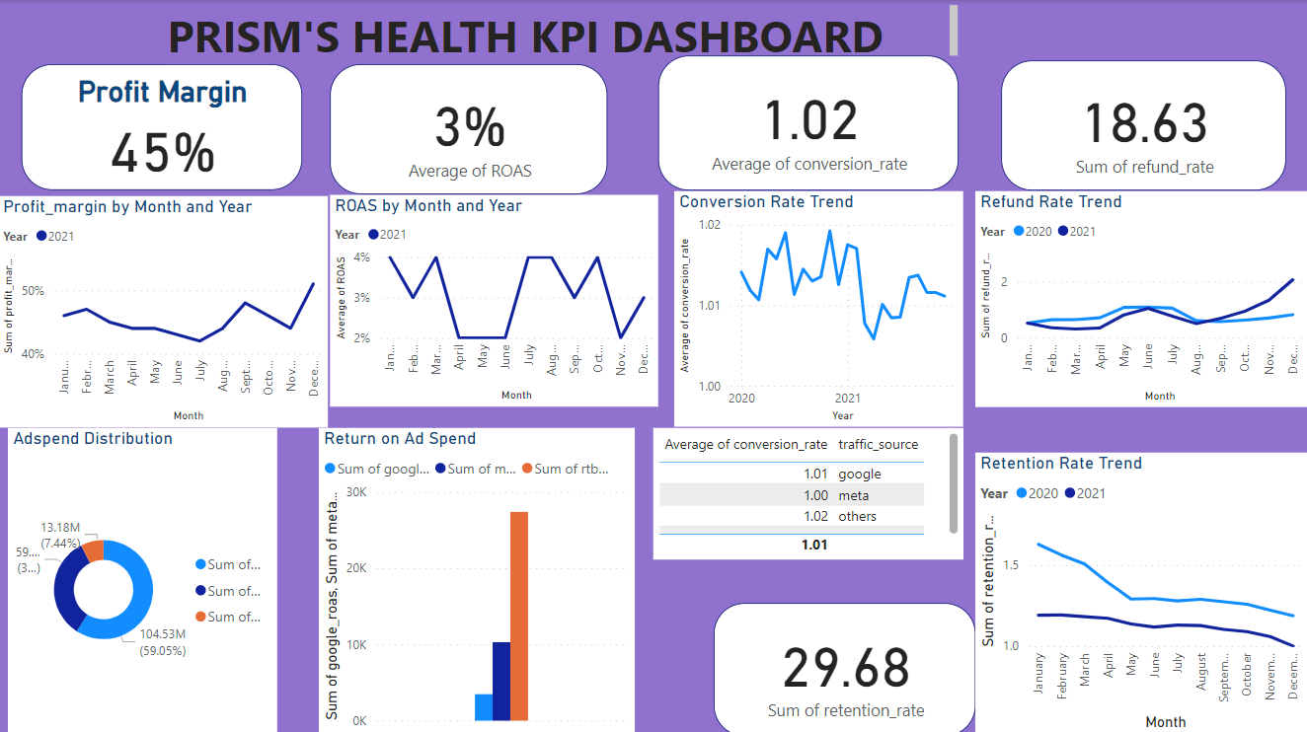
Notes:
Prism has been recently acquired by Quadrangle, a large corporation with ambitious growth goals. Prism is on a journey to become more data-driven to inform strategic decisions and enhance overall business performance.

Slide 5
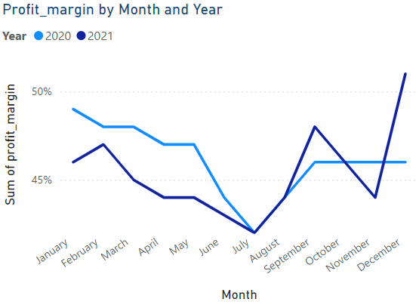
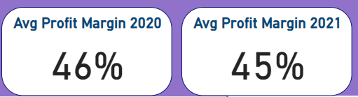
Analysis: Profit Margin
Notes:
Prism has been recently acquired by Quadrangle, a large corporation with ambitious growth goals. Prism is on a journey to become more data-driven to inform strategic decisions and enhance overall business performance.
- Profit margins have shown a consistent upward trend over the last 6 months of the analysed period.
- The business is generating significant revenue relative to its cost. Very efficient use of resources to achieve profitability.

Slide 6

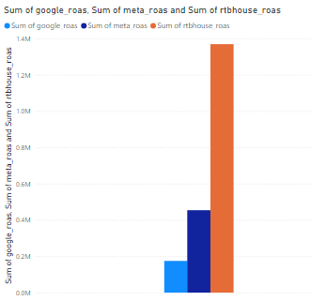
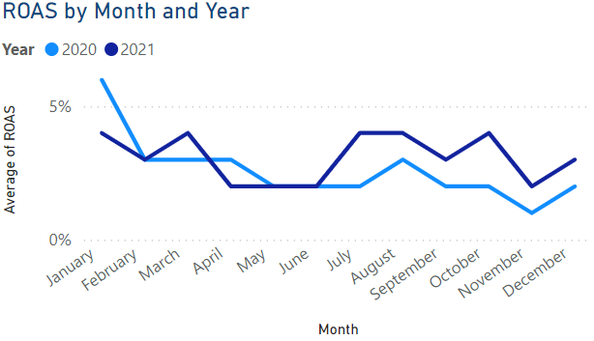
Analysis: Return on Ad spend
-ROAS appears relatively stable month-to-month but on the lower side.
- The ad spend distribution shows Google and Meta contributing significantly
Notes:
A 3% ROAS indicates that only £0.03p is generated in revenue per Ad
Suggests campaigns may not be well targeted or cost of advertising is too high relative to returns .

Slide 7
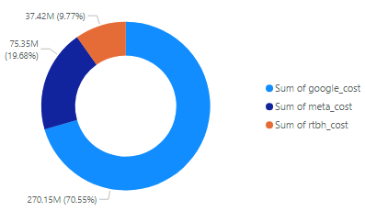
Ad spend distribution
Notes:
-Google leads ad spend distribution,
with Meta and others contributing lesser shares.
-The business heavily relies on Google which displays better targeting capabilities than the other platforms.
- Relying on one platform may be risky due to external factors such as: - Increased competition, algorithm changes, changes in cost, etc.

Slide 8
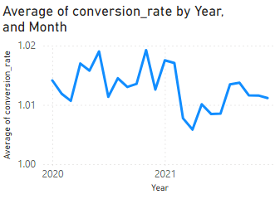
Analysis: Conversion Rate
- The average conversion rate over the 2020/2021 period is 1.01%.
-The conversion rate is fluctuating, indicating possible seasonal impacts or campaign variances.

Slide 9
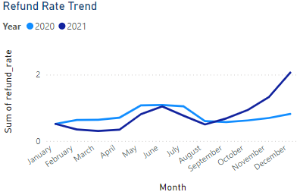
Analysis: Refund rate
- The refund rate is 18.63%.
- This requires further analysis for specific and most common reasons. Could it possibly be the Product quality or service issues? These measures must be tracked to implement some changes.

Slide 10
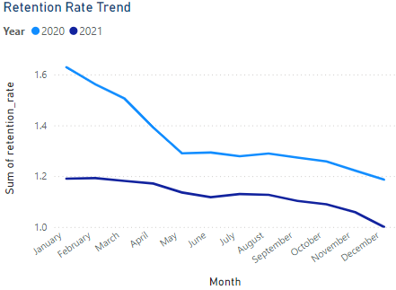
Analysis: Retention Rate
-Retention rates is 29.68%, however, shows a downward trajectory.
-This trend appears to have a correlation with the refund rate as shown previously, suggesting dissatisfied customers less likely to repeat purchases or remain loyal to Prism.
- As refunds increase, customer churn might rise
- Aim to assess ad targeting strategies, demographic of audience and creativity to identify areas for improvement

Slide 11
Recommendations
Investigate high-performing products or channels driving these margins and allocate additional resources
budget from lower-performing channels to higher-converting platforms and test new platforms
Review conversion rate data alongside traffic source performance to optimize underperforming landing pages and campaigns
Analyse reasons for refund and implement measures to address customers dissatisfaction.
Strengthen loyalty programs and personalised marketing efforts to retain customers, focusing on high- value segments
To keep monitor of channel-specific ROI and scale budgets accordingly to maximize traffic coming in.

Slide 12
Thank You !

